Slide 1

Web Application Development and Software Frameworks Unit 1 : Introduction to Web Application Designing
A.Sravani
Assistant Professor
Department of CSE
GITAM School of Technology (GST)
Visakhapatnam – 530045
Email: sandavar@gitam.edu

Slide 2
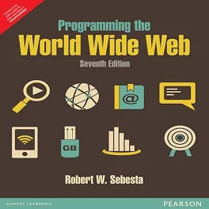
BOOKS
Text Books
ProgrammingtheWorldWideWeb,7thEdition,RobetWSebesta,Pearson,2013.
ProMeanStackDevelopment,1stEdition,ELadElrom,ApressO’Reilly,2016
JavaScript&jQuerythemissingmanual,2ndEdition,Davidsawyermcfarland,O’Reilly,2011.
WebHostingfor Dummies,1stEdition, PeterPollock,JohnWiley&Sons,2013.
RESTfulwebservices,1stEdition,LeonardRichardson,Ruby,O’Reilly,2007.
6. FULLSTACKREACT-The complete guide to ReactJS and Friends,1st Edition,Anthony Accomazzo, Leanpub,2020
Reference Books
DietelandNieto,Internetand WorldWideWeb-Howtoprogram,PHI/PearsonEducation,2006.
WebTechnologies,HTML,JavaScript,PHP,Java,JSP,XMLandAJAX,Blackbook,1stEdition,DreamTech,2009.
WebTechnologies,1stEdition7thimpression,UttamKRoy,Oxford,2012.

Slide 3
Course objectives
Design static webpage usingMarkup languages.
Design and implement webpages using stylesheets.
Implement with javascript webapplications with dynamic webpages.
Understand working of Webservers and Design Methodologies with MVC Architecture.
Develop web applications using XML.

Slide 4
Course Outcomes
After completion of the course, the student will be able to
Demonstratetheimportanceofhtml&dhtmltagsfordesigningwebpagesandseparatedesignfromcontentusingcascadingstylesheet(l2)
Designinteractiveweb Pageswithclient Andserversidescripting(l6)
Applyvalidations Onuserinput Usingjavascript(l3)
Compareandanalyzexmlandjson Documents.(L2)
Createanddeploywebapplicationsoverwebserver.(L6)

Slide 5

Syllabus
Module I: Introduction to Web Application Designing L 9 P 6
Introduction: Building a Web Application, Components – Client Side, Server-side Components, 2 tier, n-tier architectures, Networks, Protocols. MVC Pattern.
HTML5: Basic syntax, HTML document structure, text formatting, images, lists, links, tables, forms, frames.
Cascading Style Sheets (CSS3): Levels of style sheets, style specification formats, selector forms, font properties, list properties, colour properties, alignment of text, background images, The Box Model.
Module II: Client Side Scripting L 9 P 6
JavaScript: Introduction, Functions, Arrays, DOM, Built-in Objects, Regular Expression, Event handling, Validation, Dynamic documents
Module III: XML, JSON L 9 P 6
Syntax of XML, document structure, and document type definition, namespaces, XML schemas, document object model, presenting XML using CSS, XSLT, XPath, XQuery, FLOWR
JSON: Features, JSON vs. XML, JSON Data Types, JSON Objects, JSON Arrays, JSON HTML.

Slide 6
Module IV: Server side processing with Java L 6 P 6 Introduction to Servlet, Life cycle of Servlet, Servlet methods, Java Server Pages. Working with tomcat webserver
Database connectivity – Servlets, JSP, JDBC, Practice of SQL Queries
Module V: Web Application Frameworks L 9 , P 6
Introduction to Web application development frameworks, Types of Frameworks. ReactJS.
Angular JS: Introduction, Angular JS Expressions, Modules, Data Binding, Controllers, DOM, Events, Forms, Validations.
ReactJS: Introduction, components, Styling, Form programming, Building and Deployment

Slide 7
Building a Web Application
A web application also known as a web app can be accessed through a web browser.
Web applications are usually stored on remote servers, and users can access them through web browsers.
To build a web application
A developer first tries to find a solution to a specific problem.
Next, they create the web app by choosing the appropriate development framework. During the development stage, the developer engages with the end users to ensure they build the right solution.
Lastly, they test the solution and then deploy the web app.

Slide 8
Building a Web Application
There are two major parts of web-based application development:
The client side
The server side.
The client-side helps users see data from the server, while the server side helps developers store and retrieve data from the database.

Slide 9
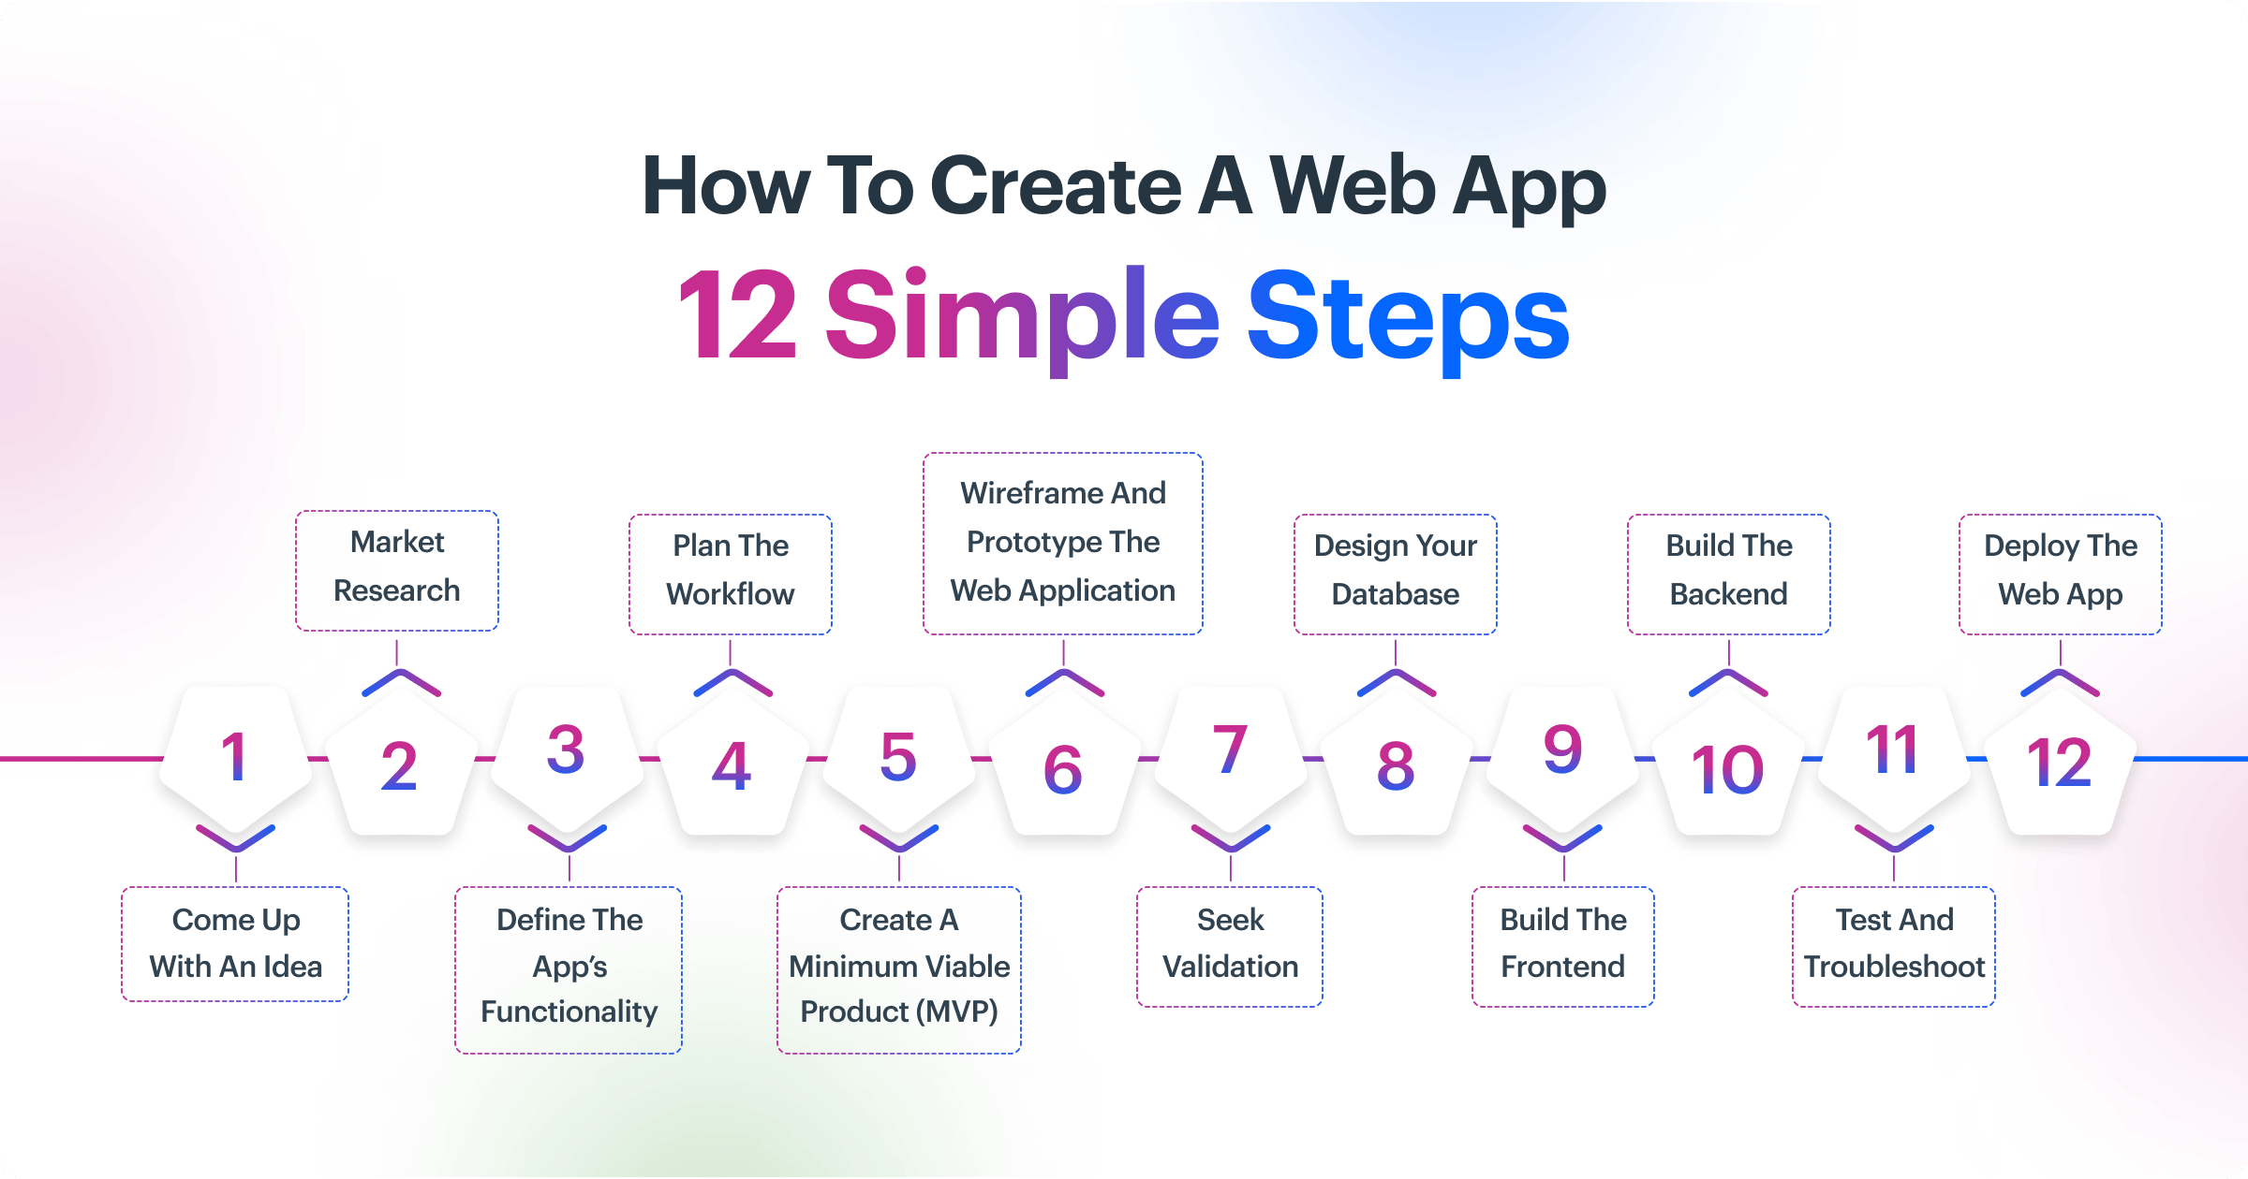

Slide 10
N-Tiered Client/Server Architecture
The client–server model is a computing model that acts as distributed application which partitions tasks or workloads between the providers of a resource or service, called servers, and service requesters, called clients.
Client server network architecture consists of two kinds of computers: clients and servers.
Clients are the computers that that do not share any of its resources but requests data and other services from the server computers and server computers provide services to the client computers by responding to client computers requests

Slide 11
2-Tier Architecture
2-tier architecture is used to describe client/server systems where the client requests resources and the server responds directly to the request, using its own resources. This means that the server does not call on another application in order to provide part of the service. It runs the client processes separately from the server processes, usually on a different computer:
The client processes provide an interface for the customer, and gather and present data usually on the customer’s computer. This part of the application is the presentation layer
The server processes provide an interface with the data store of the business. This part of the application is the data layer
The business logic that validates data, monitors security and permissions, and performs other business rules can be housed on either the client or the server, or split between the two.
Fundamental units of work required to complete the business process
Business rules can be automated by an application program.

Slide 12
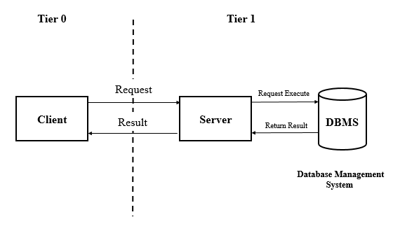
2-Tier Architecture

Slide 13
3-Tier Architecture
In 3-tier architecture, there is an intermediary level, meaning the architecture is generally split up between:
A client, i.e. the computer, which requests the resources, equipped with a user interface (usually a web browser) for presentation purposes
The application server (also called middleware), whose task it is to provide the requested resources, but by calling on another server
The data server, which provides the application server with the data it requires

Slide 14
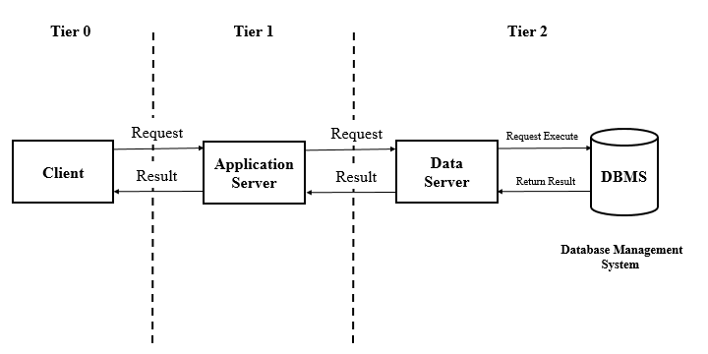
3-Tier Architecture

Slide 15
N-Tier Architecture (multi-tier)
The primary advantage of N-tier architectures is that they make load balancing possible.
Since the application logic is distributed between several servers, processing can then be more evenly distributed among those servers. N-tiered architectures are also more easily scalable, since only servers experiencing high demand, such as the application server, need be upgraded.
The primary disadvantage of N-tier architectures is that it is also more difficult to program and test an N-tier architecture due to its increased complexity.

Slide 16
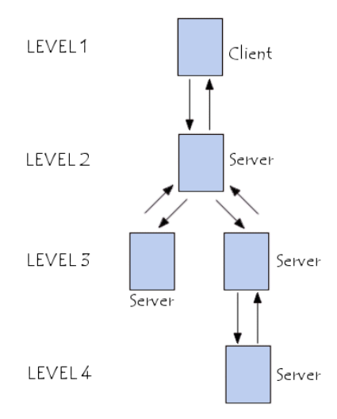
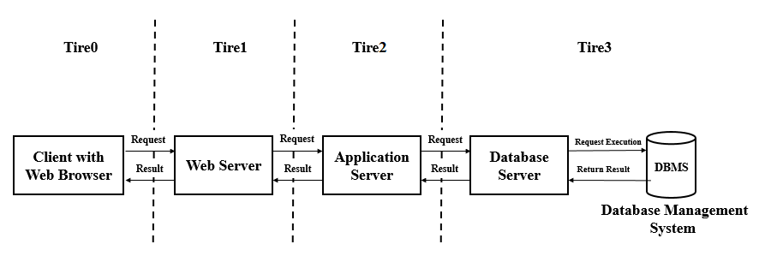
N-Tier Architecture (multi-tier)

Slide 17
Protocols
A protocol is a set of rules and guidelines for communicating data.
Rules are defined for each step and process during communication between two or more computers.
Networks have to follow these rules to successfully transmit data.
1- HTTP:
The Hypertext Transfer Protocol(HTTP) is used by the browser to tell the host computer what file it wants to retrieve.
2- IP:
The Internet Protocol (IP) is used for routing IP packets between logan's computer and the server based on IP addresses.
3- TCP:
The Transmission Control Protocol(TCP) is used for making sure the IP packets all arrive correctly and in order.

Slide 18
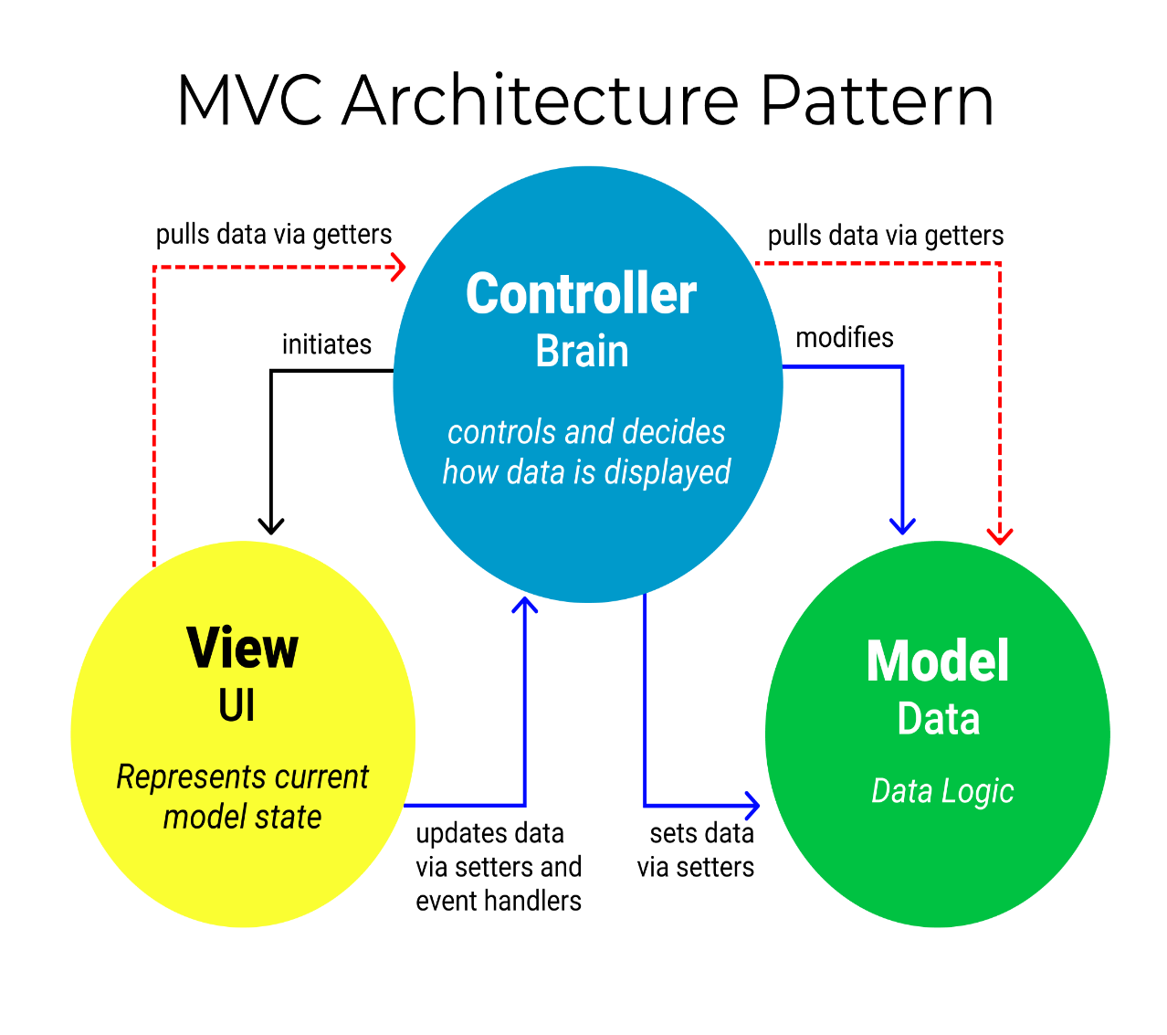
Model-View-Controller (MVC)
The Model component corresponds to all the data-related logic that the user works with. This can represent either the data that is being transferred between the View and Controller components or any other business logic-related data.
The View component is used for all the UI logic of the application.
Controllers act as an interface between Model and View components to process all the business logic and incoming requests, manipulate data using the Model component and interact with the Views to render the final output.

Slide 19
Introduction to HTML
With HTML you can create your own Web site.
Html is defined using SGML (Standard Generalized Markup language) which is an ISO standard notation for describing text-formatting languages.
HTML Versions- Since the early days of the web, there have been many versions of HTML:
Version | Year
HTML | 1991
HTML 2.0 | 1995
HTML 3.2 | 1997
HTML 4.01 | 1999
XHTML | 2000
HTML5 | 2014

Slide 20
HTML is the standard markup language for creating Web pages.
HTML stands for Hyper Text Markup Language
HTML describes the structure of Web pages using markup
HTML elements are the building blocks of HTML pages
HTML elements are represented by tags.
Hypertext is simply a piece of text that works as a link.
Mark up language is language of writing layout information within documents.
It is basically a scripting language.
It is used to define layout and attributes of a www document as well as to create links between web pages.
Some other scripting languages for creating web pages such as java script, DHTML,XML, PHP.

Slide 21
BASIC SYNTAX:
The fundamental syntactic units of HTML are called tags.
Tags are used to specify the categories of content.
The syntax of tag is tags name surrounded by angle brackets(< >).
Tags must be written in Lower case letters.
Most tags appear in pairs: an opening tag and a closing tag.
Ex: <p> content </p>
Name of a closing tag is name of its corresponding opening tag with a slash attached to the beginning.

Slide 22
8.Elements are defined by tags.
Tag format:
Opening tag: <name>
Closing tag: </name>
9. The opening tag and its closing tag together specify a container for the content they enclose
10 Not all tags have content
If a tag has no content, its form is <name />
11. The container and its content together are called an element
12. If a tag has attributes, they appear between its name and the right bracket of the opening tag
13. Comment form: <!-- … -->
14 .Browsers ignore comments, unrecognized tags, line breaks, multiple spaces, and tabs.

Slide 23
0
HTML Structure
The <html> element is the root element of an HTML page
The <head> element contains meta information about the document
The <title> element specifies a title for the document
The <body> element contains the visible page content
The <h1> element defines a large heading
<html>, <head>, <title>, and <body> are required in every document
The whole document must have <html> as its root
A document consists of a head and a body
The <title> tag is used to give the document a title, which is normally displayed in the browser’s window title bar (at the top of the display)
The <p> element defines a paragraph

Slide 24
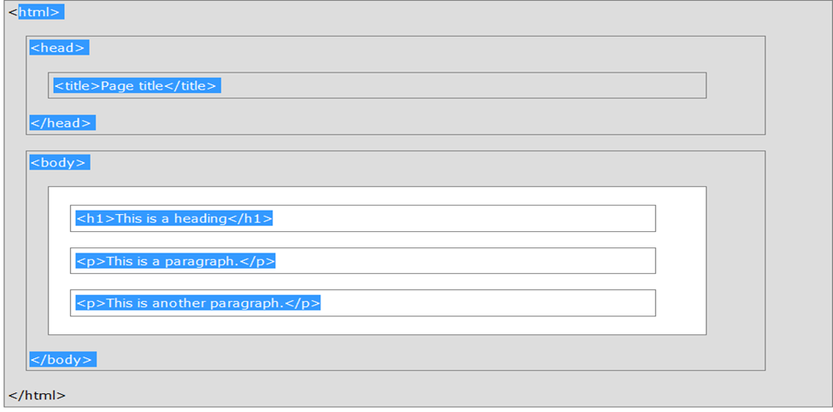
HTML Page Structure Below is a visualization of an HTML page structure:
Note: Only the content inside the <body> section (the white area above) is displayed in a browser.

Slide 25
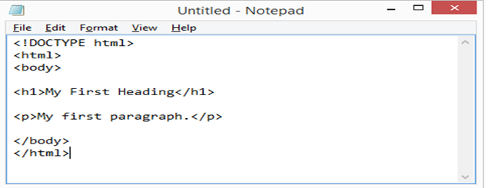
Example for executing the html program: 1.Windows 7 Open Start > Programs > Accessories > Notepad
Save the HTML Page
Save the file on your computer. Select File > Save as in the Notepad menu.
Name the file "index.htm" and set the encoding to UTF-8 (which is the preferred encoding for HTML files).

Slide 26
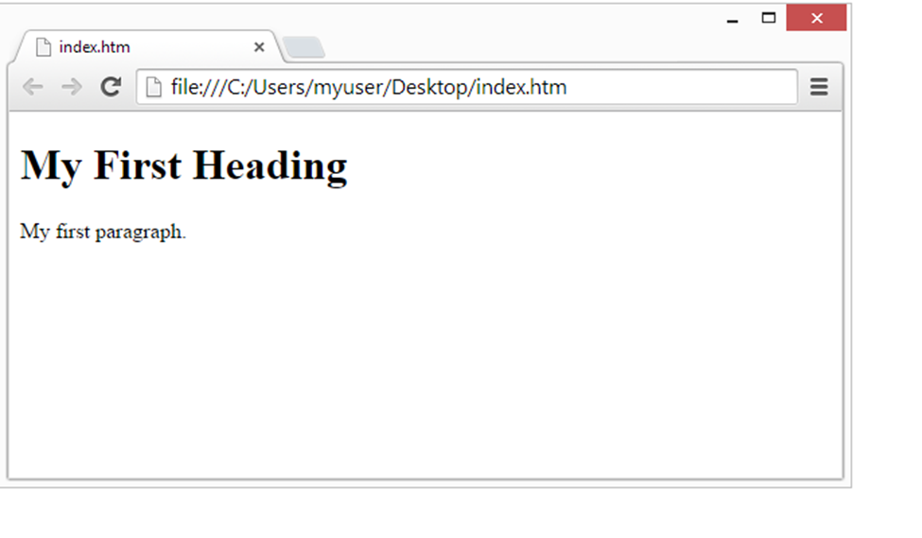
View the HTML Page in Your Browser Open the saved HTML file in your favorite browser (double click on the file, or right-click - and choose "Open with"). The result will look much like this:
*
26

Slide 27
TEXT FORMATTING
Basic Text Markup
Paragraph Elements :The HTML <p> element defines a paragraph. Text is normally placed in paragraph elements
Line Breaks: The effect of the <br /> tag is the same as that of <p>, except for the blank line and No closing tag.
Preserving white spaces: The text content of a <pre> element is displayed as it is entered

Slide 28
Headings:Headings are defined with the <h1> to <h6> tags.
<h1> defines the most important heading. <h6> defines the least important heading.
Six sizes, 1 - 6, specified with <h1> to <h6>
1, 2, and 3 use font sizes that are larger than the default font size
4 uses the default size 5 and 6 use smaller font sizes.
Block Quotations:Content of <blockquote>
Font styles and sizes:
Emphasis - <em> (often set in italics)
Strong - <strong> (often set in boldface)
Monospace - <code> (often set in Courier)
Superscripts and subscripts
Subscripts with <sub>
Superscripts with <sup>

Slide 29
Character Entities
Char. Entity Meaning
& &amp; Ampersand
< &lt; Less than
> &gt; Greater than
" &quot; Double quote
' &apos; Single quote
¼ &frac14; One quarter
½ &frac12; One half
¾ &frac34; Three quarters
° &deg; Degree
(space) &nbsp; Non-breaking space
Horizontal rules: <hr /> draws a line across the display, after a line break
Meta Element: The meta element (for search engines) Used to provide additional information about a document, with attributes, not content

Slide 30
IMAGES
In HTML, images are defined with the <img> tag.
The <img> tag is empty, it contains attributes only, and does not have a closing tag.
The src attribute specifies the URL (web address) of the image:
Syntax:<img src="url" alt="some_text" style="width:width;height:height;">
Ex:<img src="wrongname.gif" alt="HTML5 Icon" style="width:128px;height:128px;">
The alt Attribute: The alt attribute provides an alternate text for an image, if the user for some reason cannot view it (because of slow connection, an error in the src attribute, or if the user uses a screen reader).If a browser cannot find an image, it will display the value of the alt attribute.
Image Size - Width and Height
You can use the style attribute to specify the width and height of an image.
The values are specified in pixels (use px after the value).
<img src="1.jpg" alt="Mountain View" style="width:304px;height:228px;">

Slide 31
HTML Links - Hyperlinks
HTML links are hyperlinks acts as a pointer to some resource.
You can click on a link and jump to another document on the Web page or jump within the document currently being displayed
Most Web sites consists of many different documents, all logically linked together. So links are essential to build any interesting Web sites.
Note: A link does not have to be text. It can be an image or any other HTML element.
Syntax: <a href="url">link text</a>
EX:<a href="http://www.w3schools.com/html/">Visit our HTML tutorial</a>
The href attribute specifies the destination address (http://www.w3schools.com/html/) of the link.
The link text is the visible part (Visit our HTML tutorial).

Slide 32
Link that points to different document specifies the address of that document- an address might be a filename, a directory path and a filename or a complete URL
Links are specified in an attribute of an anchor tag <a> which is an inline tag
The anchor tag that specifies the link is called source of that link and document whose address is specified in the link is called target of that link.
To create links one is required, href(hypertext reference)- value assigned to href specifies the target of the link.
Ex: <a href= “ HTML introduction.html”> HTML part-1</a>

Slide 33
HTML>
<HEAD>
<TITLE>Example1 </TITLE>
<BODY>
<h1>Hello Students ,this is your first web page.- Anuradha</h1>
<a href="ex2.html"> execution</a>
</BODY>
</HTML>

Slide 34
Targets within documents(Book Marks)
https://www.w3schools.com/html/tryit.asp?filename=tryhtml_links_bookmark
If the target of a link is not in the beginning of a document, it must be some element within a document then the target element includes an id attribute; which can then be used to identify it in an href attribute
<p><a href="#C4">Jump to Chapter 4</a></p>( the browser moves the display so that h2 element whose id=“C4” is at the top.)
<h2 id="C4">Chapter 4</h2> ( all elements can include an id attribute)

Slide 35
Tables
<table> tag used to create a table
Data will be entered row-wise into HTML tables
<tr> -to create rows
<td>-to create data cells
<th> to create table head
border is an attribute of <table> tag and it is used to put a border across all the cells. If you do not need a border then you can use border="0".
The cellspacing attribute defines the width of the border, while cellpadding represents the distance between cell borders and the content within a cell.
Use colspan attribute if you want to merge two or more columns into a single column. Similar way you will use rowspan if you want to merge two or more rows.

Slide 36
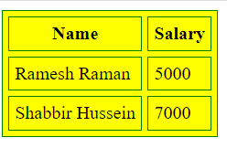
<!--DOCTYPE html table demonstration-->
<html>
<head>
<title>HTML Table Cellpadding</title>
</head>
<body>
<table border="1" cellpadding="5" cellspacing="5" bordercolor="green" bgcolor="yellow">
<tr>
<th>Name</th>
<th>Salary</th>
</tr>
<tr>
<td>Ramesh Raman</td>
<td>5000</td>
</tr>
<tr>
<td>Shabbir Hussein</td>
<td>7000</td>
</tr>
</table>
</body>
</html>

Slide 37
HTML Lists
HTML offers web authors three ways for specifying lists of information. All lists must contain one or more list elements.
Lists may contain:
<ul> - An unordered list. This will list items using plain bullets.
<ol> - An ordered list. This will use different schemes of numbers to list your items.
<dl> - A definition list. This arranges your items in the same way as they are arranged in a dictionary.
The type attribute for <ul> tag to specify the type of bullet you like.
<ul type="square">
<ul type="disc">
<ul type="circle">
The type attribute for <ol> tag to specify the type of numbering you like. By default it is a number. Following are the possible options:
<ol type="1"> - Default-Case Numerals.
<ol type="I"> - Upper-Case Numerals.
<ol type="i"> - Lower-Case Numerals.
<ol type="a"> - Lower-Case Letters.
<ol type="A"> - Upper-Case Letters.

Slide 38
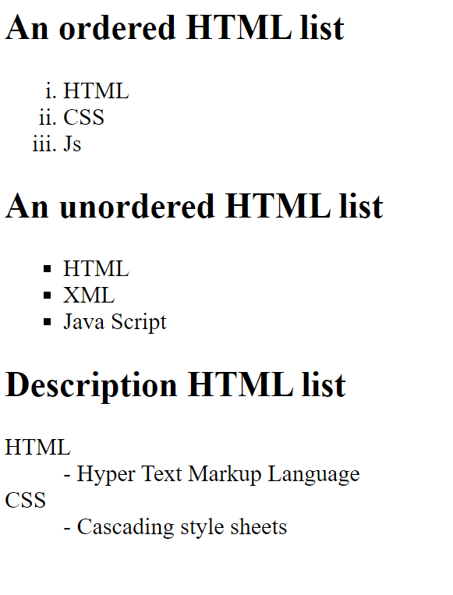
<body>
<h2>An ordered HTML list</h2>
<ol type="i">
<li>HTML</li>
<li>CSS</li>
<li>Js</li>
</ol>
<h2>An unordered HTML list</h2>
<ul type="square">
<li>HTML</li>
<li>XML</li>
<li>Java Script</li>
</ul>
<h2>Description HTML list</h2>
<dl>
<dt>HTML</dt>
<dd>- Hyper Text Markup Language</dd>
<dt>CSS</dt>
<dd>- Cascading style sheets</dd>
</dl>
</body>
</html>

Slide 39
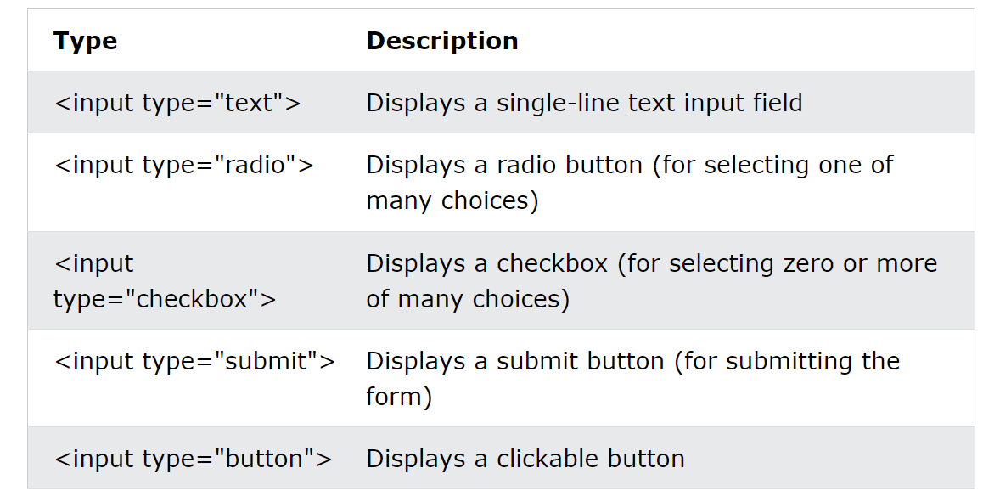
HTML Forms
<form> element is used to create an HTML form for user input

Slide 40
Sample Program
<!DOCTYPE html>
<html>
<head>
<style>
<!--Cell Padding-->
th, td {
padding-top: 10px;
padding-bottom: 10px;
padding-left: 20px;
padding-right: 20px;
}
<!--Cell Spacing-->
table {
border-spacing: 20px;
}
</style>
</head>
<body>
<Center><h2>Student Registration Form</h2>
<table>
<form action="success.html">
<tr>
<td>Roll Number</td>
<td><input type="text" id="text" name="rno"></td>
</tr>
<tr>
<td>Name of the student</td>
<td><input type="text" id="name" name="name"></td>
</tr>
<label for="Python">Python Programming</label><br>
<input type="checkbox" id="Java" name="Java" value="Java">
<label for="Java">Java Programming</label>
</tr>
<tr>
<td>
<td>
<label for="Hobbies">Choose a hobby:</label></td>
<td><select name="Hobbies" id="Hobbies">
<option value="Reading books">Reading books</option>
<option value="Listening to Music">Listening to Music</option>
<option value="Drawing">Drawing</option>
<option value="Insta reels Making">Making Insta reels</option>
</select></td>
</tr>
<tr>
<td><input type="submit" value="Submit Details"></td>
<td><input type="reset" value="clear"></td>
</tr>
</form>
</table></center>
</body>
</html>
<tr>
<td>Gender</td>
<td>
<input type="radio" id="male" name="gender" value="MALE">
<label for="male">Male</label><br>
<input type="radio" id="female" name="gender" value="Female">
<label for="Female">Female</label><br>
</td>
</tr>
<tr>
<td>Email</td>
<td><input type="email" id="email" name="email"></td>
</tr>
<tr>
<td>Address</td>
<td><textarea rows="5" cols="50" id="textarea" name="address">
Enter your detailed address here</textarea></td>
</tr>
<tr>
<td>Intrested in</td>
<td><input type="checkbox" id="C" name="C" value="C-Language">
<label for="C">C language</label><br>
<input type="checkbox" id="Python" name="Python" value="Python">

Slide 41
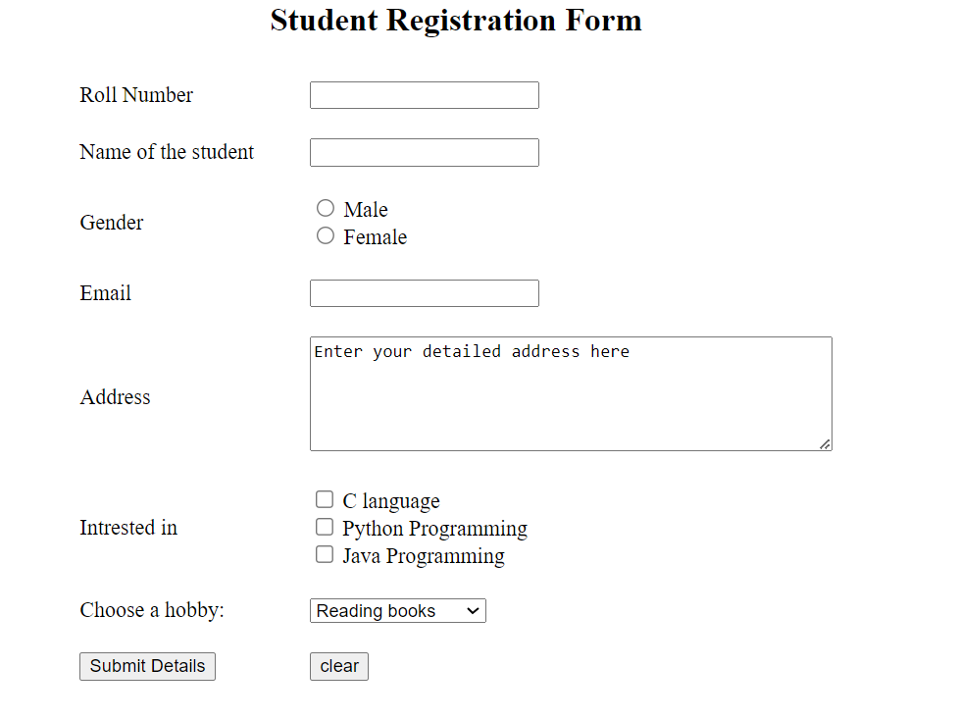

Slide 43
THANK YOU

